Slide 1
Predicting Housing Prices in Ames Using Advanced Regression Techniques
Webster Estimé and Vladzimir Kushchav
STA5167, Statistics in Applications II
Spring 20205

Slide 2
Practical Relevance
Budget Alignment: Helps families identify homes within their financial range, especially after accounting for interest rates and property taxes.
Neighborhood Evaluation: Models that highlight key predictors (like square footage, year built, neighborhood) guide families toward better long-term investment decisions.
Avoid Overpaying: Detects if a home is overpriced relative to its features and surrounding sales — ensuring better value for first-time homebuyers.

Slide 3
Practical Relevance
Data-Driven Decisions: Enables identification of underpriced homes that may yield higher returns after renovations or flipping.
Portfolio Optimization: Accurate price prediction supports better portfolio management and risk mitigation.
Scouting Opportunities: Highlights hidden gems in the market (e.g., homes with features typically linked to higher resale value).

Slide 4
Dataset Overview
📁 Source: Compiled by Dean De Cock
🌐 Origin: Obtained from a Kaggle competition on housing price prediction
📍 Location: Covers residential home sales in Ames, Iowa
🔢 Structure:
1,168 observations (training set)
81 variables, including numeric and categorical features
🏠 Target Variable: SalePrice — the final sale price of a home

Slide 5
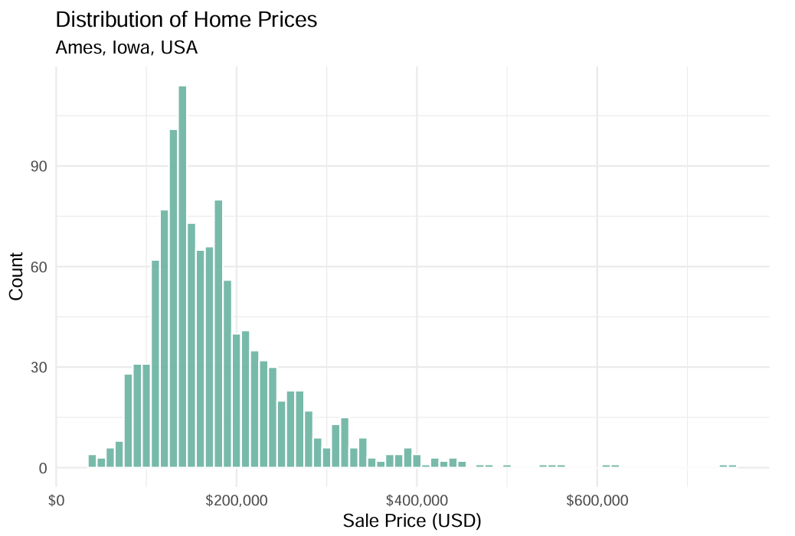

Slide 6
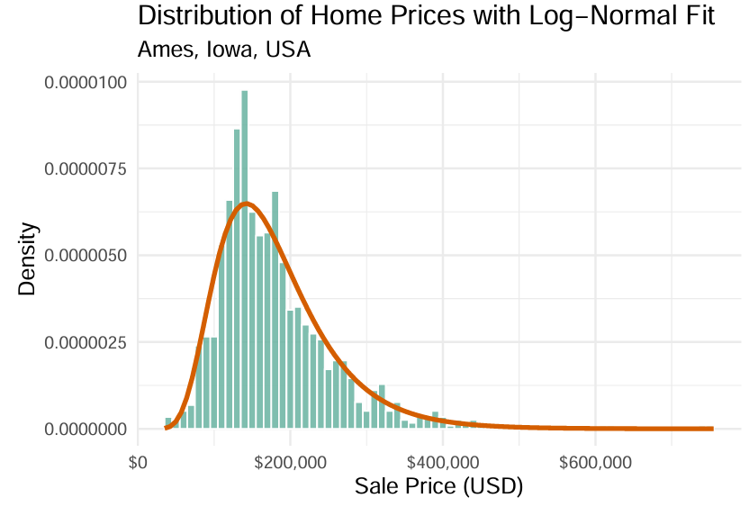

Slide 7
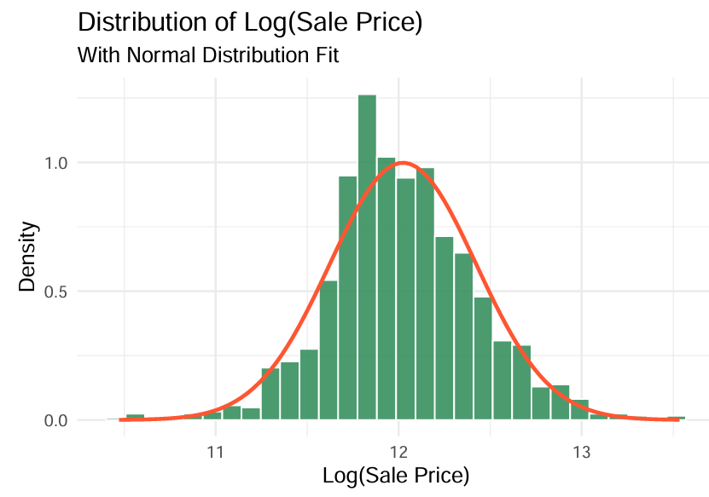

Slide 8
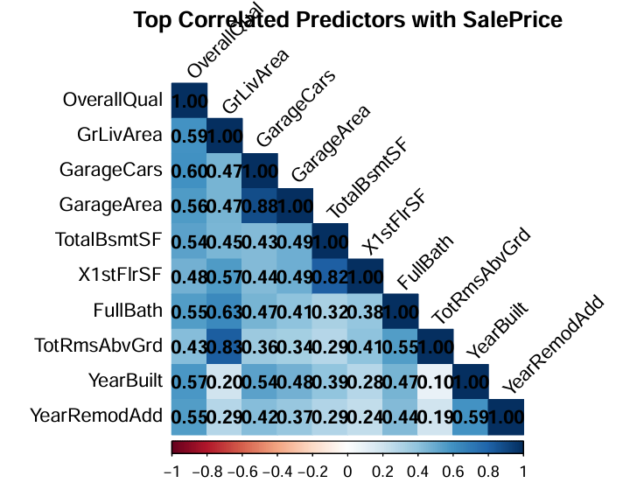

Slide 9
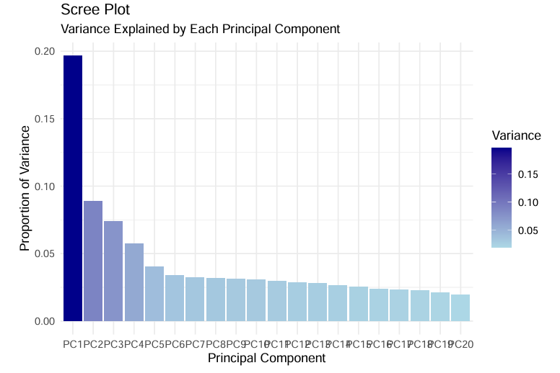

Slide 10
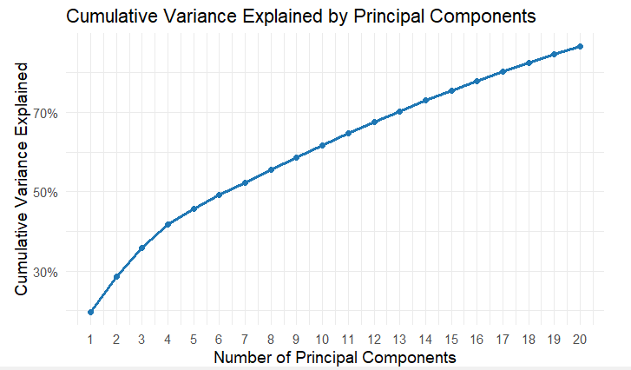

Slide 11
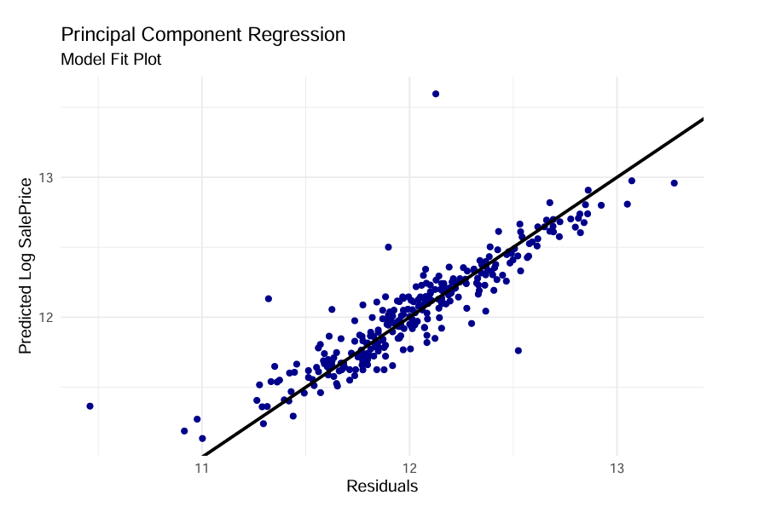

Slide 12
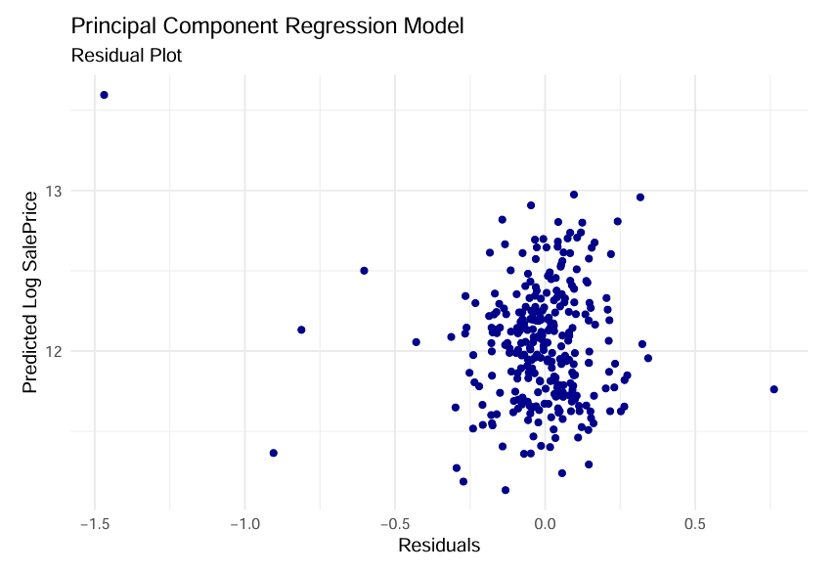

Slide 13
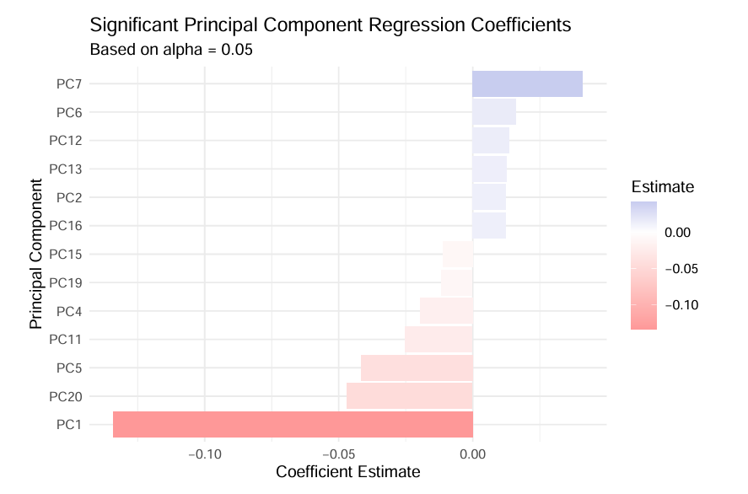

Slide 14
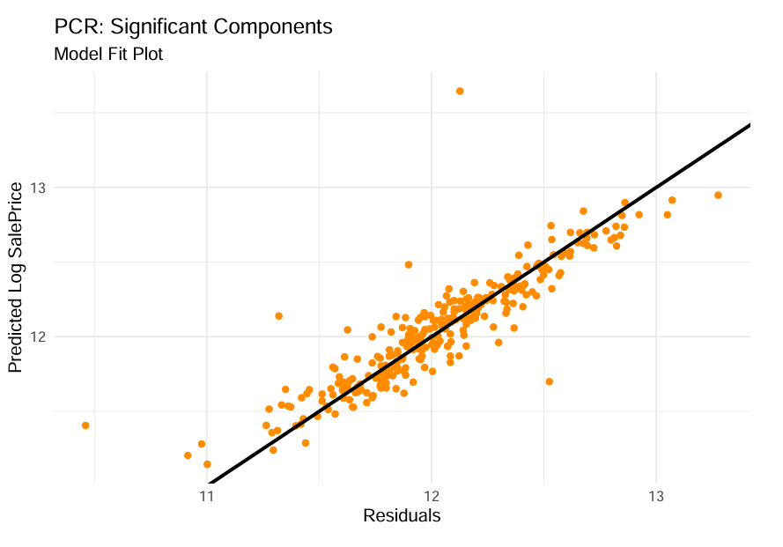

Slide 15
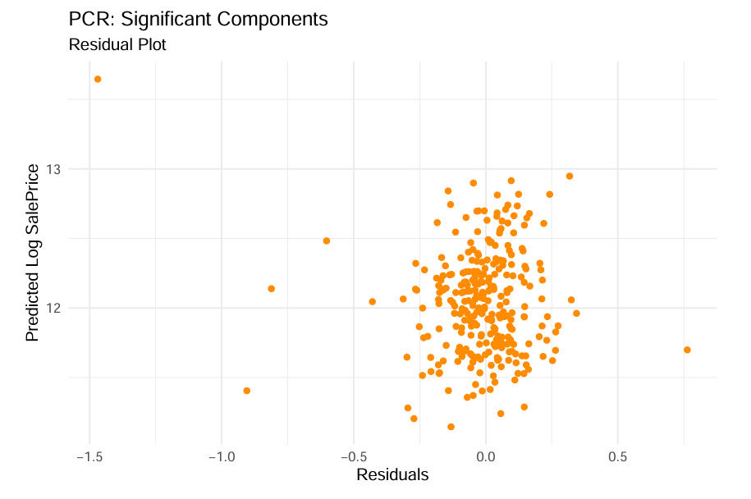

Slide 16
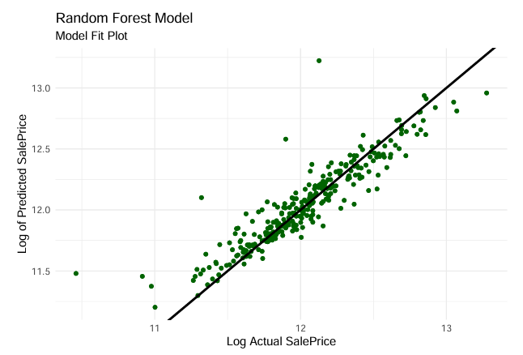

Slide 17
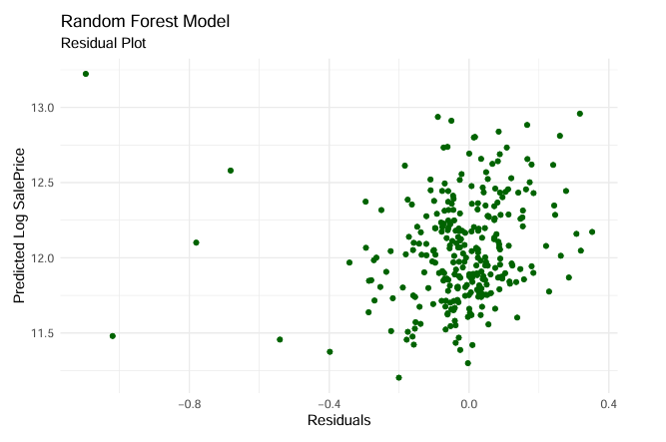

Slide 18
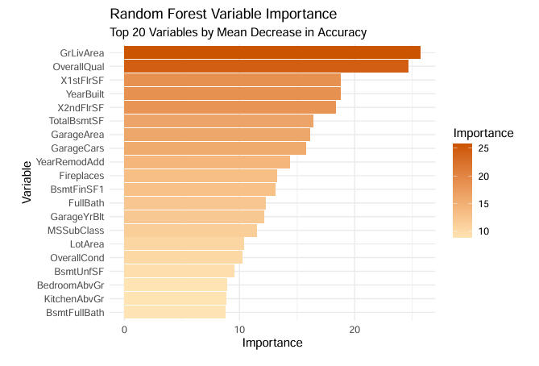

Slide 19
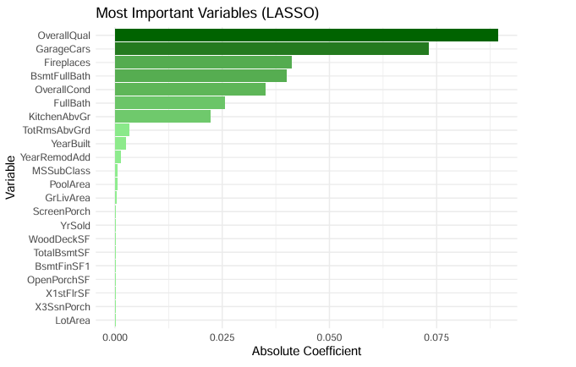

Slide 20
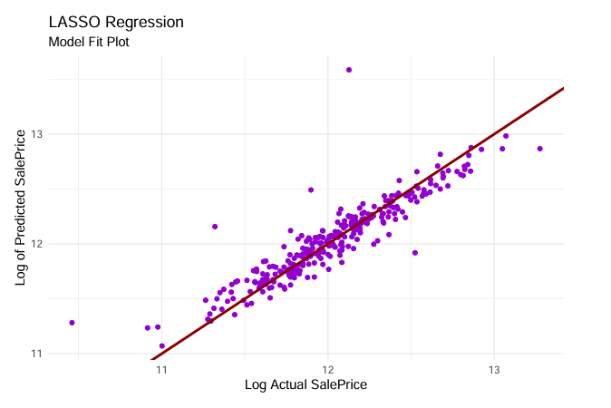

Slide 21
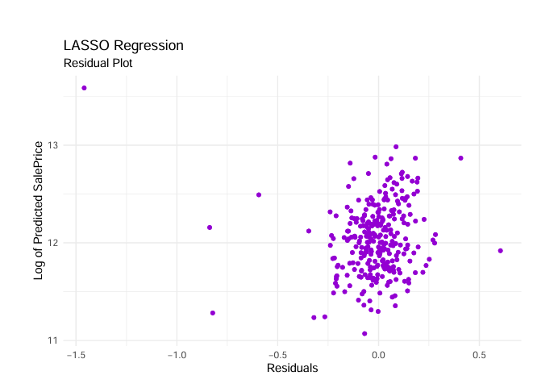

Slide 22
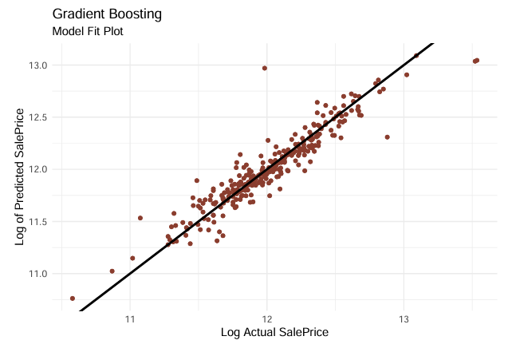

Slide 23
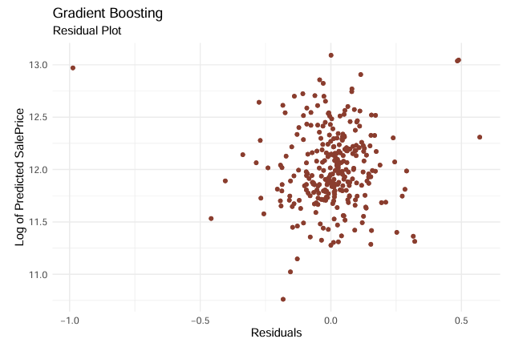

Slide 24
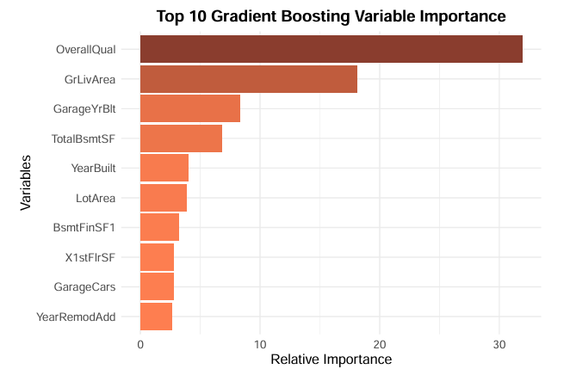

Slide 25
